Slide 1
Software?
Instructions providing desired function and performance
Computer Programs Associated Documentation
Data structure that enable program to adequately manipulate information
Documents describing operations and use of programs
Both a product and a vehicle for developing a product
Software is engineered not manufactured
Does not wear out but it does deteriorate

Slide 2
software
Many people equate the term software with computer programs.
Programs are developed by individuals for their personal use.
They are generally smaller in size and have limited functionality.
Since the author of a program himself uses and maintains his programs, they usually don’t have good user interface and lack proper documentation.

Slide 3
software
Software =programs + good user interface + operating procedures + documentations
Software is not just the programs but also all associated documentation and configuration data which is needed to make these programs operating.
It consists of a no of separate programs, configuration files, system documentation which describes the structure of the system and user documentation which explains how to use the system.
Software products have multiple users, therefore, should have good UI, proper operating procedures and good documentation support.
Software engineers are concerned with developing software products.

Slide 4
Software
Any program is a subset of software and it becomes software only if documentation and operating procedure manuals are prepared.
Program=source code + object code
Documentation= analysis (formal specification, CFD, DFD) , design (flow charts, ER diagrams), implementation (source code listing), testing ( test data, test results)
Operating procedures consists of instructions to setup and use the system
Operating procedures= user manuals (system overview, beginner’s guide, reference guide), operational manuals (installation guide, system administration guide)

Slide 5
Types of software products
Generic products
Stand alone systems which are produced by a development organization and sold on the open market to any customer who is able to buy them.
Also called shrink-wrapped software
Eg: word processors, drawing packages, project management tools
The specification of what the software should do is owned by the software developer and decisions on software change are made by the developer.
Bespoke (customized) products
Software that is commissioned by a specific customer to meet their own needs.
Eg: air traffic control software, traffic monitoring systems.
The specification of what the software should do is owned by the customer for the software and they make decisions on software changes that are required.

Slide 6
Software engineering
Engineering discipline which is concerned with all aspects of software production from early stage of system specification through a maintaining the system after it has gone into use.
Engineering discipline, all aspects of software
Engineers make things work. They apply theories, methods and tools where they are appropriate in a best manner
Is not just concerned with technical aspects but also project management, development tools, theories and methods to support software production.

Slide 7

Software engineering
.
Small wall: use common sense bringing bricks, cements
Build building!!!!
Building a small wall and building a large building are entirely different ball games.
You can use your intuition and still be successful in building a small wall, but building a large building requires knowledge of civil, architectural and other engineering principles.

Slide 8
Need of Software Engineering
Analogy with constructing Building:
Simple wall= easy, one person job, uses intuition
Multi-storeyed building???
Many sources, but size is key:
Problem : complexity
Software engineering is about managing this complexity!!

Slide 9
Software engineering
IEEE (1981): Application of a systematic, disciplined and quantifiable approach to development, operation and maintenance of software.
Sommerville (1995): Software engineering is concerned with the theories, methods and tools that are needed to develop the software products in a cost effective way.
Peer Torngren (1997): Software engineering is what software engineers do.
Stephen Schach (1999): Software engineering is a discipline whose aim is the production of fault-free software that satisfies the user’s needs and that is delivered on time and within budget.
And many more…..

Slide 10
Advantages of software engineering
Improved requirement specification
Improved cost and scheduled estimates
Improved quality
Better use of automated tools and techniques
Less defects in final product
Better maintenance of delivered software
Well defined processes
Improved reliability
Improved productivity

Slide 11
Software engineering vs computer science
CS is concerned with the theories and methods which underlie computers and software systems whereas software engineering is concerned with the practical problems of producing software
Some knowledge of CS is essential for software engineers in the same way some knowledge of physics is essential for electrical engineers
All software engineering should be underpinned by theories of CS but in reality this is not the case.
Software engineers must often use ad hoc approaches to develop the software.
Elegant theories of CS can’t always be applied to real, complex problems which require a software solution

Slide 12
Software Engineering/System Engineering
Software engineering
System engineering
is part of
Concerned with all aspects of computer-based systems development including
Hardware development, policy and process design and system deployment as well as software engineering
Concerned with all aspects of software production
System engineers are involved in
system specification, architectural design, integration and deployment

Slide 13
Software Process
Set of activities and associated results that produce the software product. Software process is the way in which we produce software. These activities are carried out by SEs. Four fundamental process activities are common to all software process
Specification - what the system should do and its development constraints
Evolution - changing the software in response to changing demands
Generic activities in all software processes
Development - production of software system to meet the specification
Validation - checking that the software is what the customer wants

Slide 14
Software Characteristics
Software does not wear out
Well understood with the help of bath tub curve.
There are three phases in the life of a h/w product
Initial phase is burn-in phase, where failure intensity is high. It is expected to test the product in the industry before delivery. Due to testing and fixing problems, failure intensity will come down initially.
The second phase is the useful life phase where the failure intensity is approx. constant and called the useful life of a product.
After few years, again failure intensity will increase due to wearing out of components, called wear out phase.
Hw components suffer from the cumulative affects of dust, vibration, abuse, temperature, environmental maladies.

Slide 15
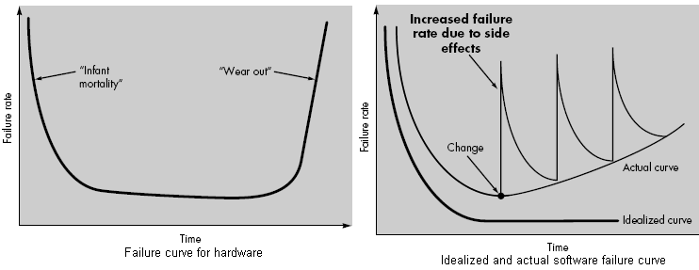
Software/hw Failure Curve

Slide 16
Software Characteristics
Software does not wear out but it does deteriorate…
Software is not susceptive to environmental maladies that cause hardware to wear out.
In theory, failure rate curve for software should take the form of the “idealized curve”.
Undiscovered defects will cause high failure rate early in the life of a program.
However, these are corrected (hopefully without introducing the other errors) so failure curve flattens.
During life, software will undergo change. As changes are made, it is likely that errors will be introduced, causing the failure rate curve to spike as in figure.
Before the curve can return to the original steady state, another change is requested, causing the curve to spike again.
Slowly, minimum failure rate level begins to rise-the software is deteriorating due to change.

Slide 17
Question???
Software maintenance involves considerably more complexity than hardware maintenance
When a hardware component wears out, it is replaced by a spare part. There are no software spare part. Every software failure indicates an error in design or in the process thorough which design was translated into machine executable code.
You can’t easily detect the exact point where the errors have been occurred!!!!

Slide 18
Software Characteristics
Software is developed or engineered, it is not manufactured in the classical sense
The life of the software begins with the requirement and analysis phase and ends up with the retirement of a software product. Development of a software is on time effort but it requires a continuous maintenance effort in order to keep it operational. However, making 100 copies is not an issue and it does not involve any cost. In case of hardware product, every product costs us due to raw materials and other processing expenses.

Slide 19
Software Crisis
The term software crisis refers to a set of problems encountered in the development of computer software during 1960s.
Within this period the software industry unsuccessfully attempted to build larger and larger software systems by simply scaling up existing development scheme.
Result
Poor quality software was produced
Development teams exceeded the budget
Late delivery of software
User requirements not completely supported by the software
Unreliable software
Difficult to maintain the produced software
Software crisis also used to encapsulate all the ills of the software and computing software industry.

Slide 20
Example: Software crisis
Anane 5 launcher
In june 1996, Anane 5 launcher broke up and exploded after 40 seconds of take off at an attitude of less than 4 km. the total loss was $500 million.
It was found that the error was due to overflow in the conversion from a 64 bit floating point number to 16 bit signed integer.

Slide 21
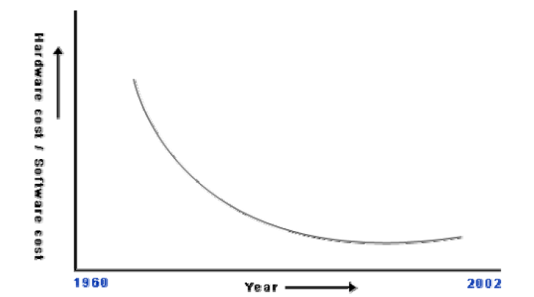
Software crisis
Organizations spending larger portion of their budget on s/w
s/w are turning out to be more expensive than h/w
use resources non-optimally; often fail to meet the user requirements; are far from being reliable; frequently crash; and are often delivered late
Among these, the trend of increasing software costs is probably the most important symptom of the present software crisis

Slide 22
Reasons for s/w crisis
Software crisis is characterized by an inability to develop s/w on time, within budget, and within requirements.
Lack of communication between s/w developers and users
Increase in size of software
Increased complexity of problem area
Project management problem
Lack of understanding of problem and its environment
High optimistic estimates regarding s/w development time and cost.

Slide 23
Emergence of Software Engineering
Early Computer Programming
- Exploratory Style
- Evolving aspect
- Use of intuition of programmers
- Use of assembly code
- About 100 lines of codes

Slide 24
Emergence of Software Engineering
High Level Language Programming
- Larger Programs
- COBOL, FORTRAN
- Exploratory Style
- Few 1000s Lines of Code
- Unstructured programs (use of goto statement)

Slide 25
Emergence of Software Engineering
Control Flow Based Programming
Flow Chart Technique used
- Focus on Design of Program’s control flow structure
- Structured programming
(only use sequential, selection, iterations)

Slide 26
Emergence of Software Engineering
Data Structure Oriented
- Several thousands of Lines of Code
- Focus given to Data Structure first

Slide 27
Emergence of Software Engineering
Unstructured Program Structured Program
If(bal>withdrl){
issue_money = TRUE;
goto 110:
} elseif (priv_cust == TRUE){
goto 100;
else
goto 140;
activate_cash_dispenser();
print(error);
If(priv_cust||(bal>withdrl){
activate_cash_dispenser();
} else
print(error);

Slide 28
Emergence of Software Engineering
Data Flow Oriented Design
- Use of Data Flow Diagrams
Represents Data Items and Functions
- Program Structure is Designed from DFD
Username
Authenticate
Welcome Msg + Username
Grant Access
Password
Database

Slide 29
Emergence of Software Engineering
Object Oriented Design
- Objects are identified first
then Relationships between them
- Code reuse, easy Maintenance

Slide 30
Evolution of Software Design Techniques
Exploratory Style
Control Flow Oriented
Data Structure Oriented
Data Flow Oriented
Object Oriented

Slide 31




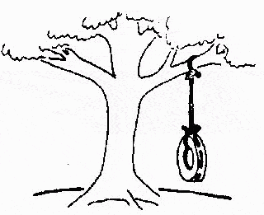
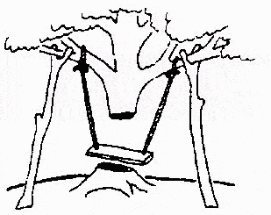
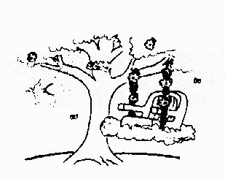
How Programs Are Usually Written …
The developers understood it in that way
This is how problem is solved now
Requirements specification was defined like this
This is how problem was solved before.
This, in fact, is what the customer wanted … ;-)
That is program after debugging
This is how program is described by marketing department

